Slide 1


Revolutionizing Chama Savings in Africa
Welcome, investors and stakeholders, to a presentation on a groundbreaking solution poised to transform informal savings groups, known as Chamas, across Africa. We're here to share our vision for a FinTech product that addresses critical pain points and unlocks unprecedented growth in this vital sector of the African economy.
by liso

Slide 2

Addressing the Core Challenges of Chama Contributions
The Problem: Missed Contributions
Manual Tracking: A Source of Errors
A staggering 78% of Chamas in Kenya fail to meet their financial goals due to forgotten or delayed contributions, as highlighted by the Central Bank of Kenya in 2023. This is a significant barrier to financial inclusion and wealth creation.
Reliance on manual tracking systems leads to frequent errors, disputes among members, and an overwhelming administrative burden for treasurers. This inefficiency stifles the growth potential of Chamas.
Erosion of Trust: Lack of Visibility
Without real-time visibility into balances and contributions, trust among Chama members erodes. This lack of transparency can lead to internal conflicts and ultimately, the dissolution of the group.

Slide 3
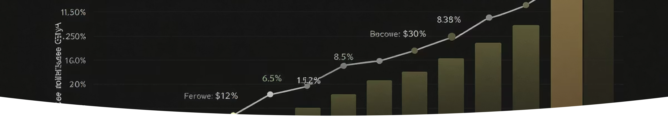
Our Product Objectives: Driving Efficiency and Trust
90%
<5 min
1,000
30%
Reduce Late Payments
Eliminate Disputes
Drive Adoption
Boost Revenue Growth
Increase on-time contribution rates from 58% to 90%, ensuring consistent financial flow for Chamas.
Reduce reconciliation time to less than 5 minutes per month, minimizing conflicts over balances.
Achieve 1,000 active Chamas within the first 6 months, demonstrating rapid market penetration.
Convert 30% of free users to premium subscribers, establishing a sustainable revenue stream.

Slide 4





Solution Overview: The WhatsApp Bot Workflow
Our solution centers around an intuitive WhatsApp bot, designed to streamline the entire contribution process. Here's how it works:
Reminder Trigger
Personalized Message
Automated reminders are sent three days before the contribution due date.
Members receive a personalized WhatsApp message with their contribution details.
Payment Confirmation
Real-Time Updates
Payments made via M-Pesa are auto-confirmed through SMS parsing.
Balances are updated in real-time, providing instant visibility to all members.

Slide 5
Core Features: Empowering Every Chama
Intelligent Reminders
Balance Broadcasts
Our free tier includes custom weekly, bi-weekly, or monthly schedules, with a 3-tier escalation system (72hr, 24hr, Due Day + hourly). Users can toggle between Swahili and English.
Auto-generated after each contribution, these broadcasts provide a visual breakdown of paid vs. pending members. A simple "BAL" request triggers an instant group update, enhancing transparency.
Auto-Tracking
The bot processes M-Pesa SMS receipts (amount, date, transaction ID) and forwarded receipts from Equitel and Airtel Money. Discrepancy alerts flag mismatched amounts, ensuring accuracy.

Slide 6
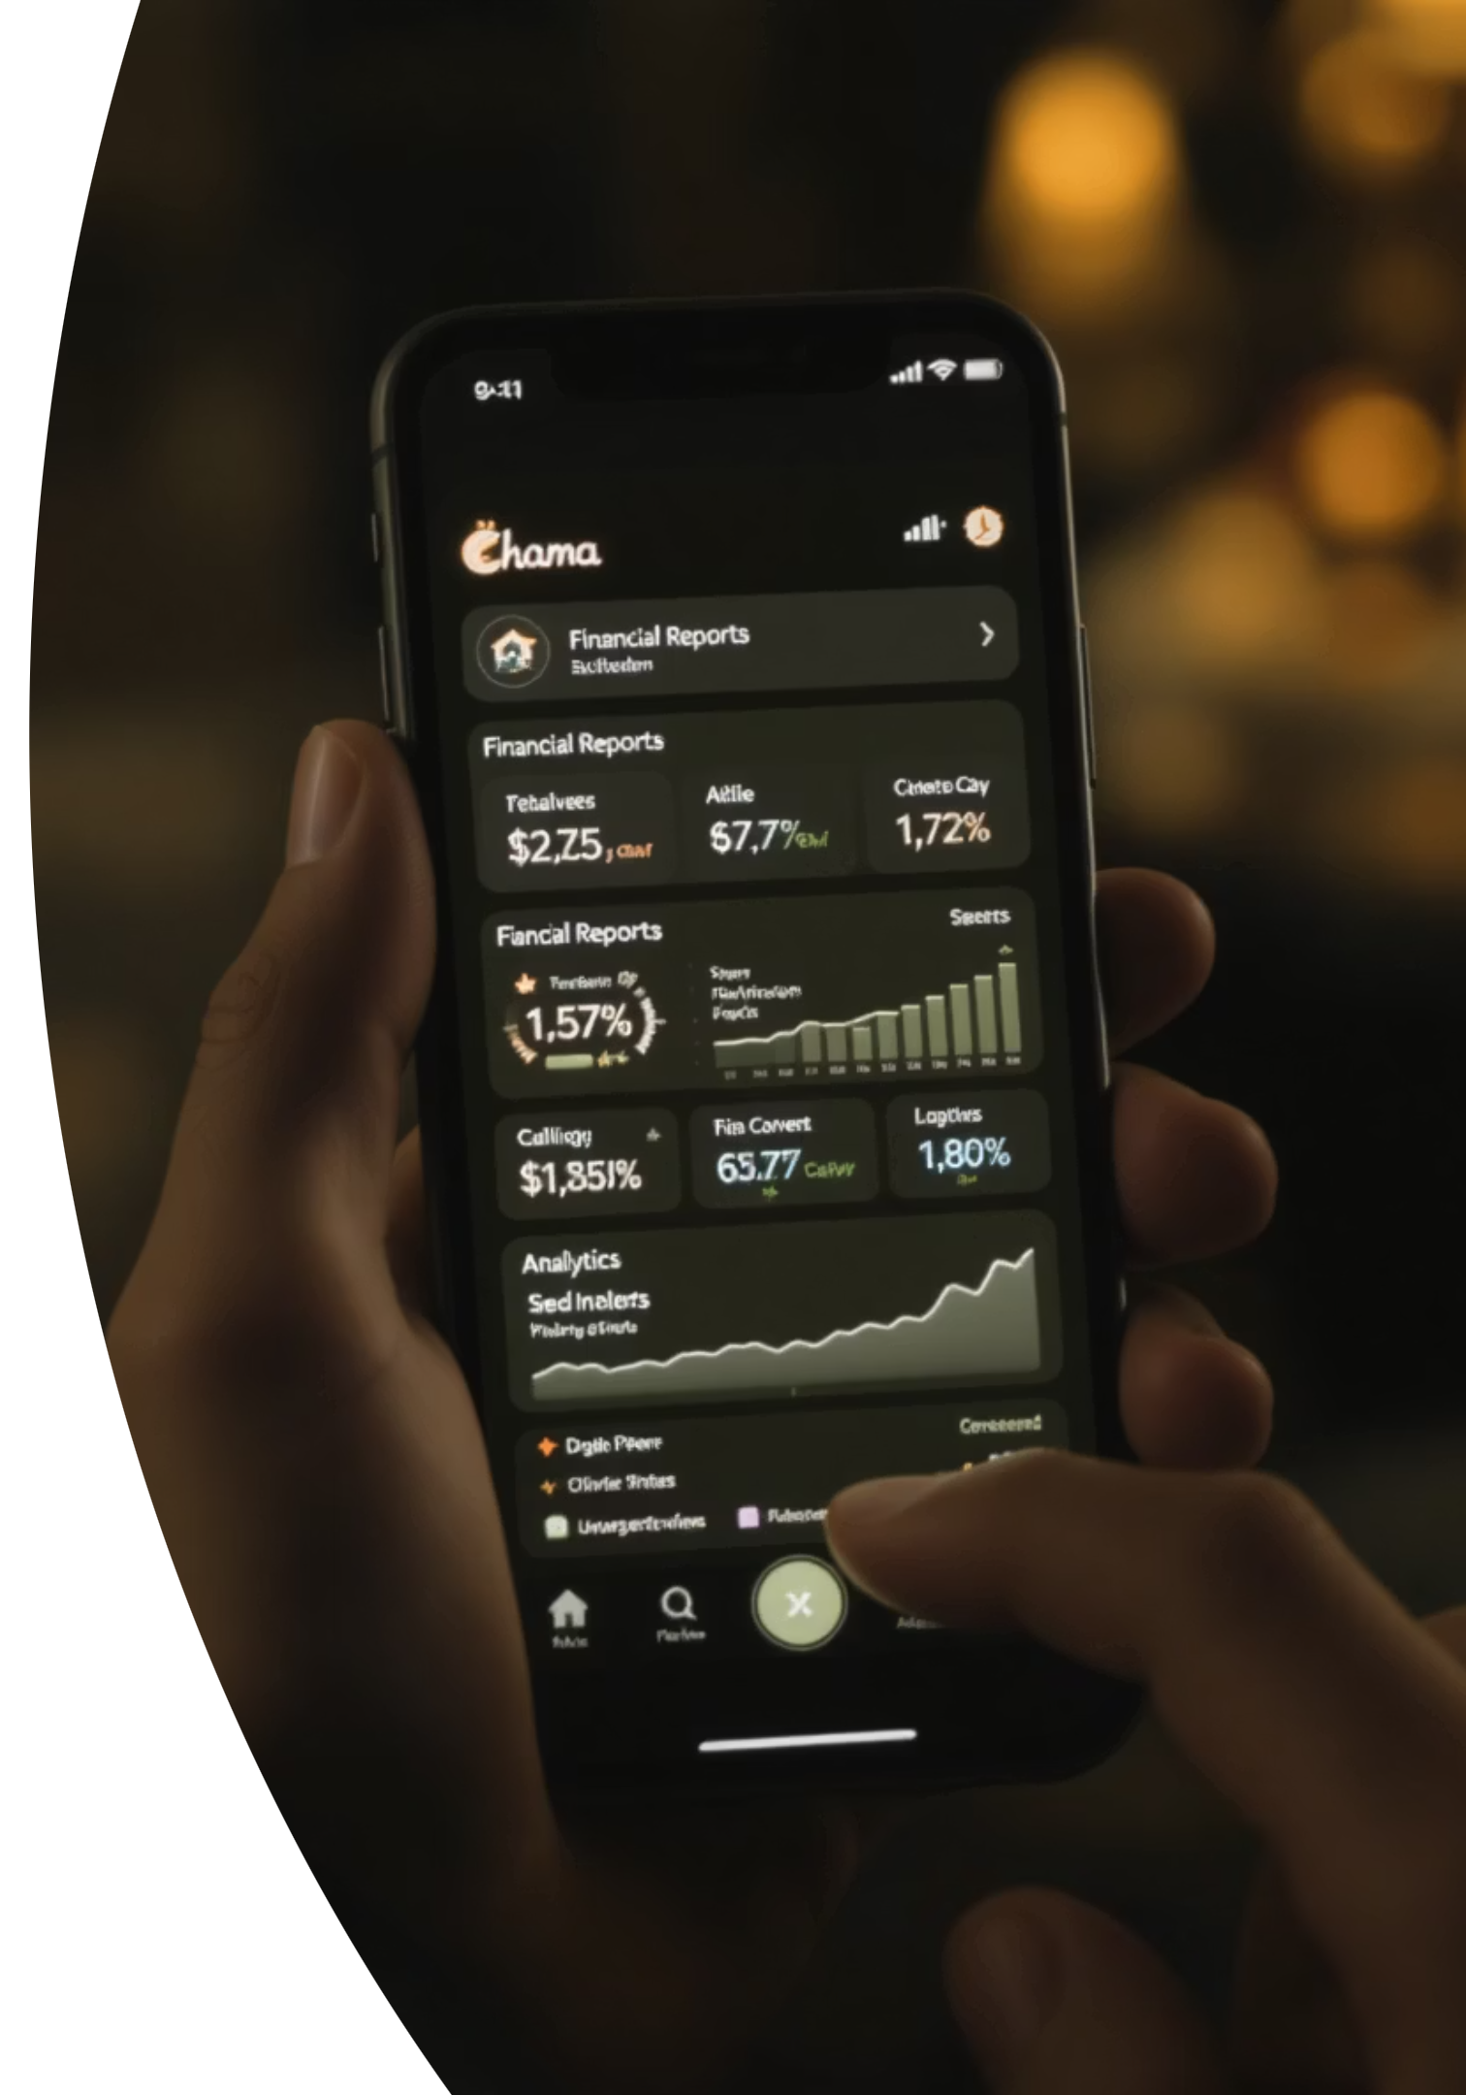
Premium Features: Unlocking Deeper Insights and Control
Smart PDF Reports (KES 100/month)
Comprehensive contribution history with highlights for late payments, customizable interest calculations, and projected payout dates, offering detailed financial oversight.
Savings Insights
Includes a "Group Health Score" based on timeliness and growth rate, anonymous peer benchmarking, and goal tracking (e.g., "72% to land purchase target"), guiding better financial decisions.
SMS Reminders (Add-on: KES 1/message)
A crucial failover for WhatsApp offline users, providing urgent alerts with delivery receipts, ensuring no contribution is missed.

Slide 7
Monetization Strategy: Sustainable Growth and Impact
Our tiered monetization strategy ensures accessibility while driving sustainable revenue growth.
Growth Levers
Referral program: 1 month free for each new Chama referred.
70%
NGO partnerships: Subsidized access for women's groups, fostering social impact.
Base Subscription Uptake
Tiered pricing: KES 500/month for Chamas with over 50 members, catering to larger groups.
KES 100/Chama/month
Savings Consultations: KES 500/session for enterprise Chamas.
45%
PDF Report Pack Usage
KES 50/month
15%
SMS Reminders Usage
KES 1/message

Slide 8

Roadmap to Success: Phased Development and Expansion
Phase 1 (MVP)
Phase 3 (Q4)
Launch with core reminders, M-Pesa tracking, and basic balance broadcasts, focusing on foundational functionality.
Implement auto-advance from group funds and introduce a government compliance toolkit, expanding the product's scope and value.
1
2
3
Phase 2 (Q3)
Develop the PDF reports engine and integrate Swahili Natural Language Processing (NLP) for enhanced user interaction.

Slide 9





Mitigating Risks and Ensuring Long-Term Stability
We have proactively identified potential risks and developed robust mitigation strategies to ensure the long-term stability and success of our platform.
SMS Delivery Failures
Our system employs a WhatsApp + SMS failover mechanism, guaranteeing delivery of critical alerts even in connectivity issues.
M-Pesa Parsing Errors
We've implemented manual override capabilities and advanced regex tuning to correct any discrepancies in M-Pesa transaction parsing.
Data Privacy Concerns
All data is secured with end-to-end encryption, ensuring the highest level of privacy and compliance with data protection regulations.
Payment Disputes
A transparent blockchain audit trail is maintained for all transactions, providing an immutable record to resolve any payment disputes.

